Slide 1




Chapter 1:
Double Spending Problem
Beginners Guide to Filecoin
Content created by Brown Zhang
Researcher @ KEN Labs

Slide 2
Double-spending occur with digital currency
Two ways to process any transaction –
Online: A transaction that uses virtual/digital currency. (double spending can occurs)
Offline: A transaction that uses actual cash or money.

Slide 3
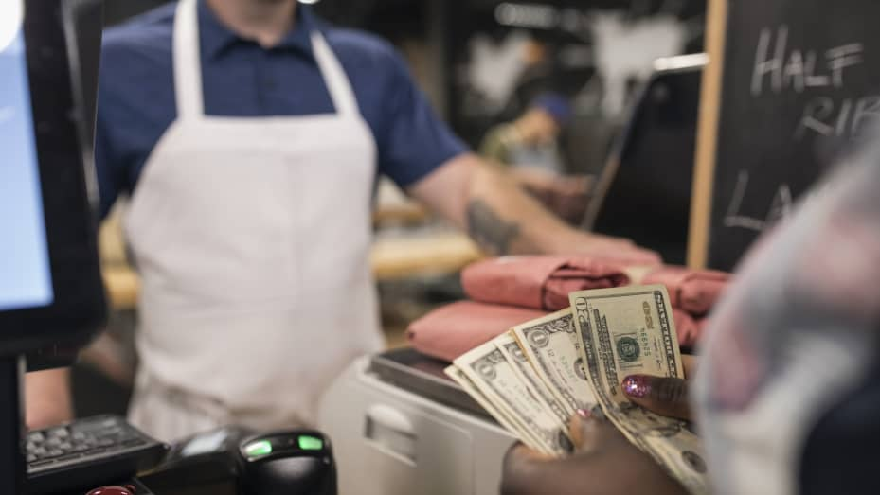
You visit a restaurant and order a pot of coffee worth $5 and you pay with cash.

Slide 4
Why Is Double-spending Problematic For Digital Currency?
Consequent problems…
Digital money is far different from physical money.
1
What prevents someone from duplicating a transaction and retransmitting it before the confirmation of the transaction from the network?
The network would not be able to tell which transaction was authentic.
2
The transaction of digital money is broadcast to all of the nodes within the network.
Nodes must wait for the transaction to be received and confirmed, which takes time.
3

Slide 5
Bitcoin Does Not Have A Central Bank To Resolve Conflicts
Digital currency circulated on the internet before Bitcoin was created. Banks and other financial organizations were in charge of overseeing and regulating it all.
Results in increased costs and extended transaction delays.
Bitcoin address these constraints by developing a system that is fully reliant on cryptographic evidence rather than trust.
Bitcoin provides a mechanism to do financial business devoid of banks.
1
2
Banks serving as mediators in banking conflicts have the drawback that transactions can be undone if a conflict arises.

Slide 6
Every Bitcoin Displays The Ownership History
Bitcoin white paper:
“A sequence of digital signatures”
When a bitcoin owner transfers a coin to another, they sign the public key of the new owner and a hash of the prior transaction.
1
3
2
Both a private key (a password that only the owner knows) and a public key (an address) is stored in each digital wallet.
The Bitcoin is then completed by appending this hash.
4

Slide 7
The Blockchain Of Bitcoin Contains A Universal Ledger
Bitcoin uses a global ledger known as a blockchain to address the double-spending issue.
All bitcoin transactions are formally broadcast to every node. The sequence in which they were acquired can then be agreed upon as a unified history.
1
3
The blockchain offers a mechanism for all nodes to be knowledgeable of every transaction.
Double-spending efforts made after that point are ineffective in bitcoin since most nodes will concur on which transaction was the first to be received.
2
4

Slide 8
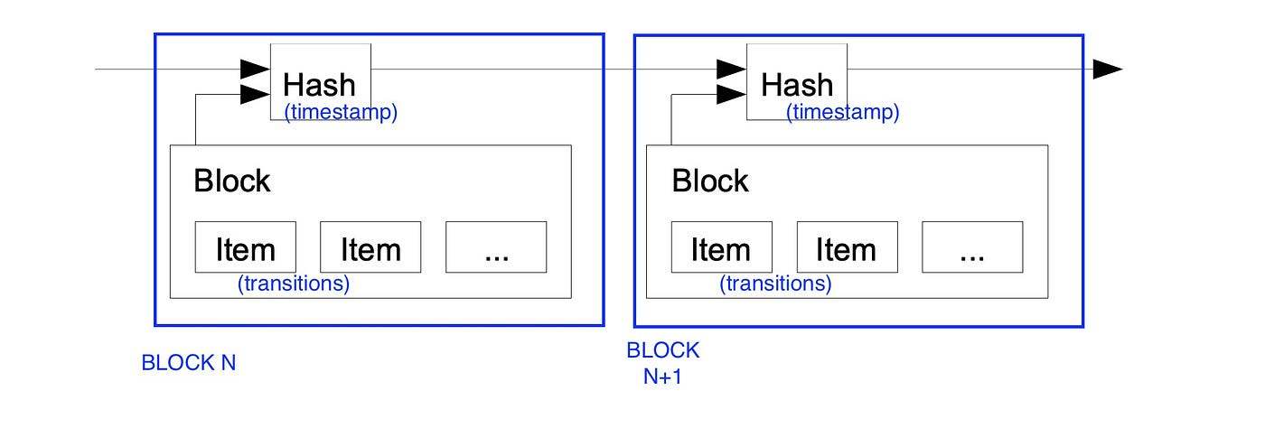
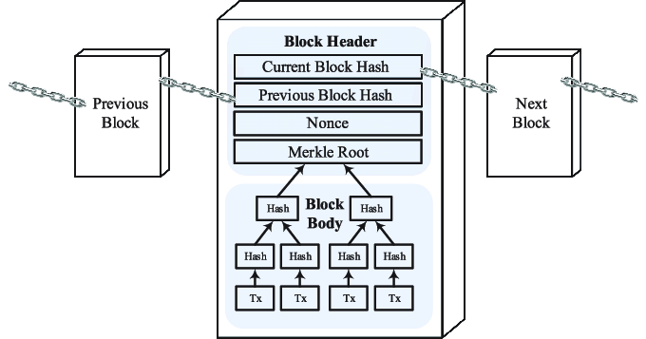
Timestamp Server
Satoshi Nakamoto’s white paper:
“Double spending issue —> A timestamp server”
A block of transactions is hashed by this server, which then broadcasts the hash to every node in the Bitcoin network.
Result:
None of the information in the hash could have been produced following the publication of the hash.
Immutable (unchangeable) log of the sequence.
Each timestamp builds on the ones that came before it.

Slide 9
Every Bitcoin Transaction Ever Performed Is Recorded
Since the first Bitcoin client was delivered in 2009, the blockchain of bitcoin has preserved an exhaustive record of all transactions ever done in order to properly comprehend how the blockchain avoids double spending.
The record cannot be changed since every transaction is cryptographically hashed to the preceding blocks.
This database is referred to as a blockchain because a fresh batch of transactions, known as a block, is added to it every ten minutes.

Slide 10
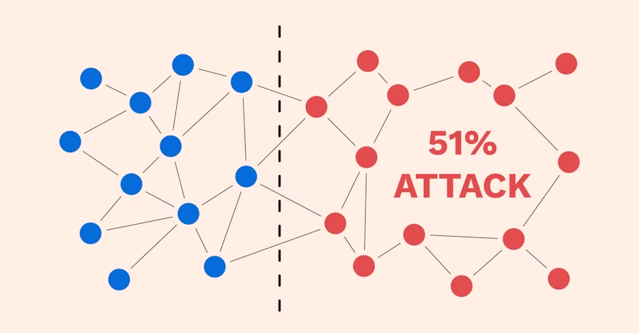

Slide 11
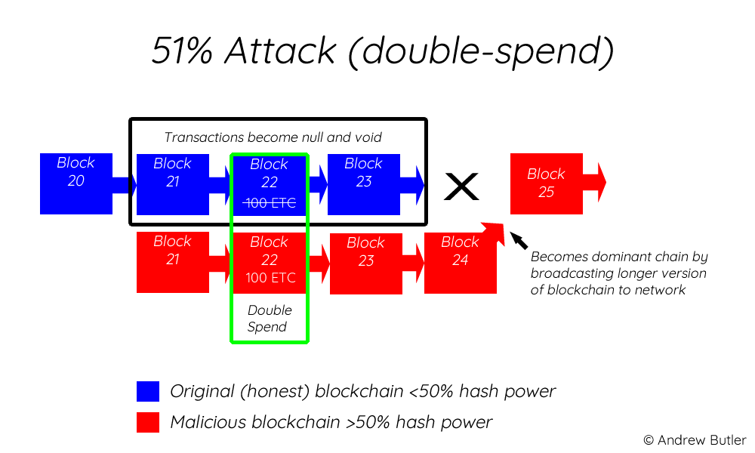
51% Attack
Having control of 51% of the network’s nodes provides the governing parties with the ability to change the blockchain.
Payments between a few or all users might be stopped if the attackers were able to stop fresh transactions from receiving confirmations. The ability to undo decisions taken when they were in charge would likewise be available to them.
One of the problems that consensus systems like proof-of-work were designed to avoid double-spendings.

Slide 12
Conclusion
Blockchain stops double-spending by broadcasting groups of transactions to all nodes in the network and timestamping them.
Transactions are irreversible and hard to tamper with since they are timestamped on the blockchain and quantitatively tied to earlier ones.

Slide 13

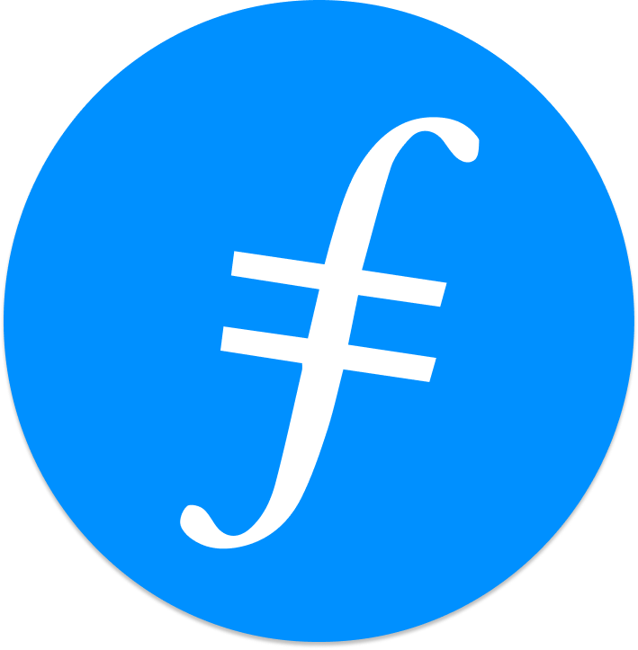
Feedback is welcomed.
https://github.com/kenlabs/Beginners-Guide-to-Filecoin

